Slide 1

CloudChase Technology
Case Study of Cloud Migration
Cloud Chasers - IST 615
Jack Dolitsky, Connor Caromile, Joseph Maugeri

Slide 2

CloudChase Technology - Case Study context
CloudChase Tec. Is an international High-tech manufacturing company
Several plants located across the globe, HQ in Germany on top of a manufacturing plant.
HQ hosts and manages an SAP ERP system on mainframe in Germany.
Sister plants connect to the business warehouse through the SAP ERP portal.
All plants make a variety of components with lots of inter-company shipping performed
Some real-world business like CloudChase include Micron, Surmotech, Intel Corp, and ASE Technology
The company is has been experiencing rapid growth over the past 5 years.

Slide 3
CloudChase Technology – Current State
SAP NetWeaver for ABAP system software hosted/managed by German Plant.
Uses Material Master, CRM, Quality, ERP, and customized modules
Sister plants connect through GUI interface to access and commit data
The ERP is most important for tracking component and product shipping,
Active Directory managed separately from ERP login
All plants manage HR/Payroll, Visualization, and some aspects of analysis in other systems, or through replicating data from the ERP
The Legacy ERP system has accumulated many problems from continual deployment over the past 20 years;
Dead Stock
Deprecated modules
Inconsistent usage & collaboration across plants
Multiple Custom Modules built to serve individual plants

Slide 4
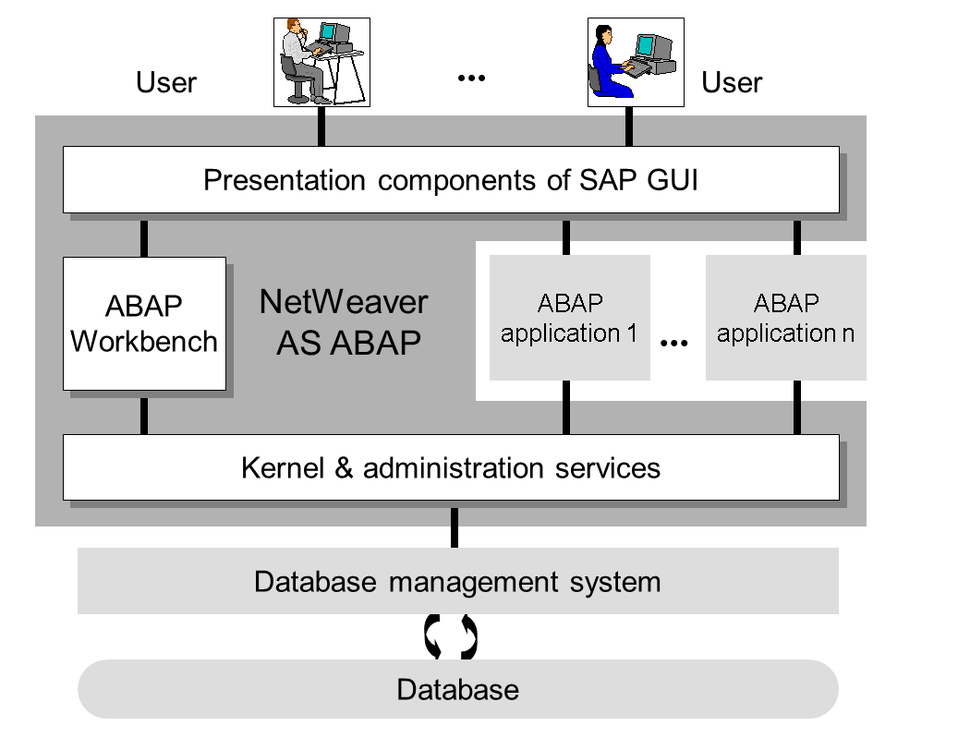
All Plants
Select Staff
German Plant
Notes:
Potential Cut

Slide 5

CloudChase Technology – Current State
Germany, 100 TB ALL HOSTING( 20 Used for Own Plant), 10 TB ON PREM(Ultipro, etc.), 120 TB Backup of All Resources
Sweden, 10 TB SAP ERP (Replicated locally) , 4 TB ON PREM, 8 TB ON PREM BACKUP
Taiwan, 10 TB SAP ERP replicated, 4 TB ON PREM, 8 TB ON PREM BACKUP
China/Hong Kong replicated, 10 TB SAP ERP, 4 TB ON PREM, 8 TB ON PREM BACKUP
Japan, 10 TB SAP ERP replicated, 4 TB ON PREM, 8 TB ON PREM BACKUP
Korea, 10 TB SAP ERP replicated, 4 TB ON PREM, 8 TB ON PREM BACKUP
USA, 20 TB SAP ERP replicated, 10 TB ON PREM, 40 TB ON PREM BACKUP
England, 10 TB SAP ERP replicated, 4 TB ON PREM, 8 TB ON PREM BACKUP
Here is the required space needed to upkeep the current operations performed in the company

Slide 6

CloudChase Technology - Case for Migration
Cost time as a function dealing with SAP ERP through Germany
Rapid growth is causing expansion problems
What works in Germany may not be effective for others.
Timezone conflicts
Language barriers
On prem failure can affect one branch critically

Slide 7

CloudChase Technology – Business Solution
SAP has provided software solutions for businesses for over 60 years, and has more recently begun to provide Cloud Solutions as well
SAP S/4 HANA Cloud environment is a highly compatible environment for our business case based on the following reasons
Pre-existing data in SAP is much easier to migrate into SAP S/4 HANA cloud than any other, as the cloud is designed to hold Modular SAP data
Our company has had a relationship with SAP for over 20 years
It's possible that SAP will eventually stop providing support for our legacy system
SAP S/4 HANA cloud can perform functions that our current resources outside of SAP ERP inside the Cloud environment
SAP offers a hybrid cloud environment; resources that we cannot go to the Cloud can be integrated where needed, or kept in a multi-cloud structure
https://www.sap.com/insights/what-is-cloud-computing.html

Slide 8
CloudChase Technology – Logistic Problems without Cloud
Everyone outside of the German branch is one step removed from critical aspects of the business warehouse.
Analysts in Germany can’t collaborate directly within our environment
Current systems without cloud create a bottleneck from German HQ to other sites.
Critical supply chain analytic visualizations are limited to one branch for view, which causes our agile methodology to suffer.
1 or 2 people at other sites who have access to systems in Germany, access is still limited. Query requests for direct access to information on Germany HQ systems must first go through onsite analysts then sent to the German HQ analysts.
Sometime there is miscommunication on what information is requested and sent when having to go through all these different channels between onsite analysts and Germany HQ.

Slide 9
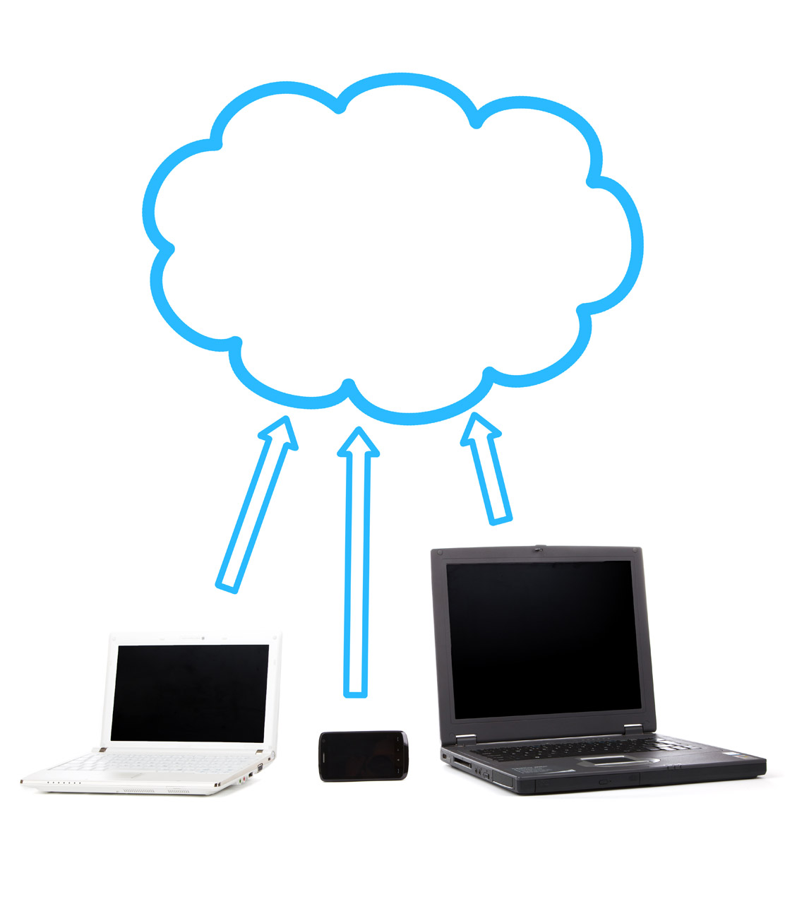
CloudChase Technology – Logistic Benefits with Cloud
Migrating systems to the cloud will remove many of the logistical problems that are created with current systems.
Will link many systems together ensuring Germany HQ and other sites are up-to-date with crucial information.
Will allow everyone to see real time updates to files and other information. Cutting down on time people spend requesting then waiting for information & files.
Decreased downtime for managing changes, with cloud-based features for developers to improve their capabilities creating and managing changes. (Developing on the ABAP Platform | SAP Help Portal)
Deeper customized UI development for applications
All classic ABAP Development enhanced through tools, profiling, and metadata analysis
Cloud Chasers is continuingly grown, currently at a rapid pace, migrating to the cloud ensures that the increased workloads are compensated for by allotting more resources when needed.

Slide 10
CloudChase Technology – Management Problem
The ineffectiveness of our current environment for our rapid growth is causing latency, consistency, and operational issues.
Global Team are unable to collaborate with plant leaders off advanced interactive analytic dashboards.
Management teams that wish to use visualization software must replicate data outside of SAP to generate visualizations
1.0 Prod to 20230301
1.1 Prod from 20230301
2.0 CRM
3.0 Development

Slide 11
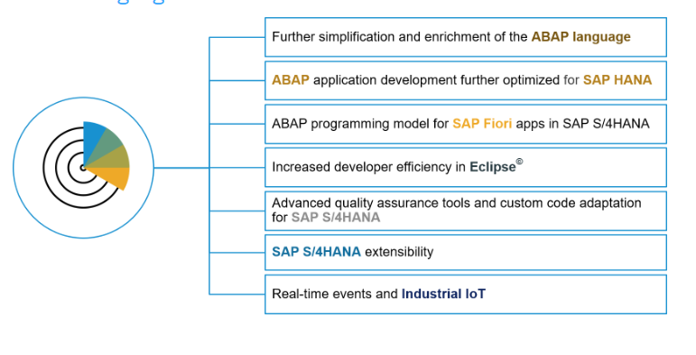
CloudChase Technology – Management Solution
SAP is already optimizing Netweaver to be hosted on the S/4 HANA cloud
Global applications can be developed to improve all plants accessibility to data
Features designed as solutions for dead stock are available in addition to the cloud
ABAP development can happen across the business
SAP NetWeaver AS for ABAP 7.52 – Available now! | SAP Blogs
Database Migration Option (DMO) (sap.com)

Slide 12

CloudChase Technology – Security Benefits
Provide an SSO to our staff with multi-factor authentication
Greater security, and helps with IT to manage the agency
Ensures all data and other company information is stored in proper locations and accesses by proper company personal who have been given access.
Can easily limit or allow access to certain databases and files.
Currently requesting data from Germany HQ requires a user to go through multiple channels and requests, going to the cloud will limit interaction and possible human error when transferring sensitive business information.

Slide 13
CloudChase Technology – Financial Analysis
Financial Analysis was estimated based on numbers from only US Office (largest workload) and Germany HQ
SAP Cloud Intergration for Data Services
Integrate data between on-premise and cloud on a scheduled (batch) basis.
Price: EUR 850.00/month
SAP Cloud Portal Service
Create role-based, multi-channel sites to access business apps and content.
Price: EUR 3,450.00/month
SAP Cloud Transportation Management
Manage transports of development artifacts and application-specific content.
Price: EUR 1,800.00/month
SAP S/4 HANA Cloud
Store, process, and federate data in a cloud infrastructure.
Price: EUR 14,250.00/month
Total Rough Estimate Coast: EUR 20,350.00/month
Company current annual revenue $410,000,000
We request granular information on our current upkeep & costs to perform the following analysis
Downtime comparisons
Cost of replication of data
Cost of additional management software
Logistic time loss overall
Financial Analysis was done using the SAP Discovery Centers financial analysis calculator and used higher estimated values about company information on data usages and number of users.

Slide 14

CloudChase Technology – Questions

Slide 15
References
Images Used
CAP : SAP. capire - Choose Your Preferred Tools. (n.d.). Retrieved March 20, 2023, from https://cap.cloud.sap/docs/tools/
SAP Cloud Application Programming Model. Community. (n.d.). Retrieved March 20, 2023, from https://community.sap.com/topics/cloud-application-programming
SAP SE. (2022). Financial performance: SAP integrated report 2021. SAP. (2022). Retrieved February 15, 2023, from https://www.sap.com/integrated-reports/2021/en/financial-performance.html
Neto, M. D. (2014, March 18). A brief history of cloud computing. Cloud computing news. Retrieved February 11, 2023, from https://www.ibm.com/blogs/cloud-computing/2014/03/18/a-brief-history-of-cloud-computing-3/
SAP Discovery Center. (n.d.). SAP Discovery Center. Retrieved March 19, 2023, from https://discovery-center.cloud.sap/estimator/?commercialModel=cpea
SAP HANA Cloud Capacity Unit Estimator. (n.d.). Retrieved March 19, 2023, from https://hcsizingestimator.cfapps.eu10.hana.ondemand.com/
© 2022 SAP SE. (n.d.). From inventing the enterprise software sector to helping the World Run Better. SAP. Retrieved February 11, 2023, from https://www.sap.com/about/company/history.html?pdf-asset=b8b97eef-5f7e-0010-bca6-c68f7e60039b&page=1
2022 SAP SE. (n.d.). From inventing the enterprise software sector to helping the World Run Better. SAP. Retrieved February 11, 2023, from https://www.sap.com/about/company/history.html?pdf-asset=b8b97eef-5f7e-0010-bca6-c68f7e60039b&page=1
SAP SE. (n.d.). Database Migration SAP. Database migration option (DMO). Retrieved March 20, 2023, from https://support.sap.com/en/tools/software-logistics-tools/software-update-manager/database-migration-option-dmo.html
SAP SE. (2022). SAP business model canvas. Vizologi. (n.d.). Retrieved February 15, 2023, from https://vizologi.com/business-strategy-canvas/sap-business-model-canvas/
SAP SE. (2022). SAP discovery center. SAP Discovery Center. (2022). Retrieved February 11, 2023, from https://discovery-center.cloud.sap/missions/?appType=platform&category=all
SAP SE. (2022). History: 2001 - 2010: About sap. SAP. Retrieved February 11, 2023, from https://www.sap.com/about/company/history/2001-2010.html
SAP SE. (n.d.). History: 1981 - 1990: About sap. SAP. Retrieved February 11, 2023, from https://www.sap.com/about/company/history/1981-1990.html
SAP SE. (n.d.). History: 1991 - 2000: About sap. SAP. Retrieved February 11, 2023, from https://www.sap.com/about/company/history/1991-2000.html
SAP SE. (n.d.). History: 2011 - present: About sap. SAP. Retrieved February 11, 2023, from https://www.sap.com/about/company/history/2011-present.html
Sheldon, P. (2013, June 6). SAP to acquire hybris - what does it mean? Forbes. Retrieved February 15, 2023, from https://www.forbes.com/sites/forrester/2013/06/05/sap-to-acquire-hybris-what-does-it-mean/?sh=1960cbcf22f8
Velush, L. (2022, November 29). Hello azure: Unpacking how Microsoft moved its SAP workload to the cloud. Inside Track Blog. Retrieved February 11, 2023, from https://www.microsoft.com/insidetrack/blog/hello-azure-unpacking-microsoft-moved-sap-workload-cloud/#:~:text=Microsoft%20is%20heavily%20invested%20in%20SAP%20applications%E2%80%94it%20uses,SAP%20workload%20to%20the%20cloud%20and%20Microsoft%20Azure.
Rajput, K. (2023, March 17). Introduction to SAP data migration cockpit – part 1. SAP Blogs. Retrieved March 20, 2023, from https://blogs.sap.com/2023/03/17/introduction-to-sap-data-migration-cockpit-part-1/
Slide 2 - https://www.travelers.com/resources/business-industries/technology/preparing-high-tech-manufacturers-for-global-risks
Slide 4 - https://help.sap.com/doc/saphelp_nw73ehp1/7.31.19/en-US/fc/eb2e97358411d1829f0000e829fbfe/content.htm?no_cache=true
Slide 5- https://www.go2group.com/wp-content/uploads/2020/05/Cloud-migration-Blog-Banner-.jpg
Slide 6- https://th.bing.com/th/id/R.da6f8d301ab3de2241f27014d1884188?rik=tIw1%2bi%2fKWA86AQ&riu=http%3a%2f%2fwww.galendata.com%2fwp-content%2fuploads%2f2019%2f03%2fcloud-computing-healthcare.png&ehk=tFLPWqPjr3OuykbvxQGC0yFFrehaxDw7u5dgpS0ZBAY%3d&risl=&pid=ImgRaw&r=0
Slide 11- https://blogs.sap.com/2017/09/14/sap-netweaver-as-for-abap-7.52-available-now/

